Slide 1
Report on IDEP Activities
(Doc Ref. No. E/ECA/COE/41/17)
Karima Bounemra Ben Soltane
Director, IDEP
March 16, 2023

Slide 2

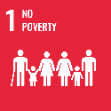





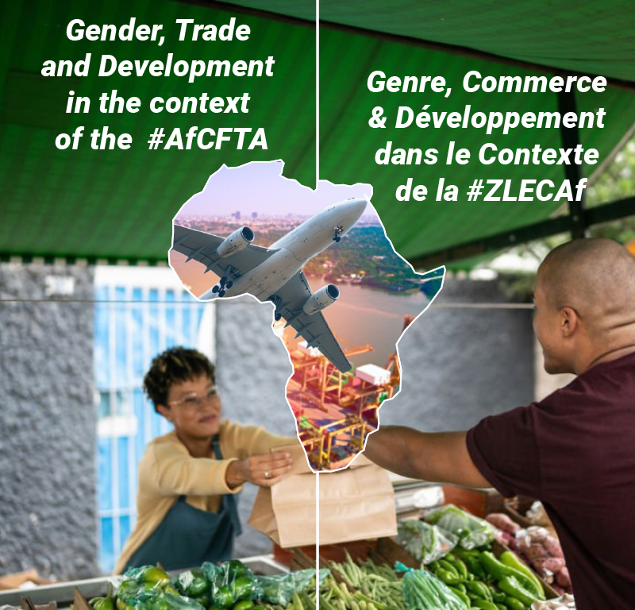
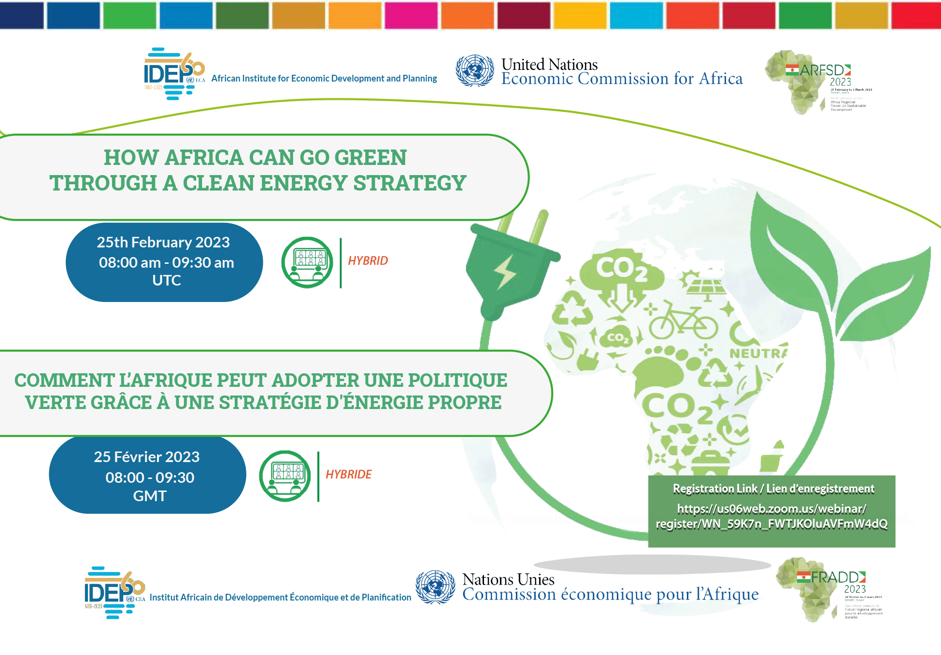


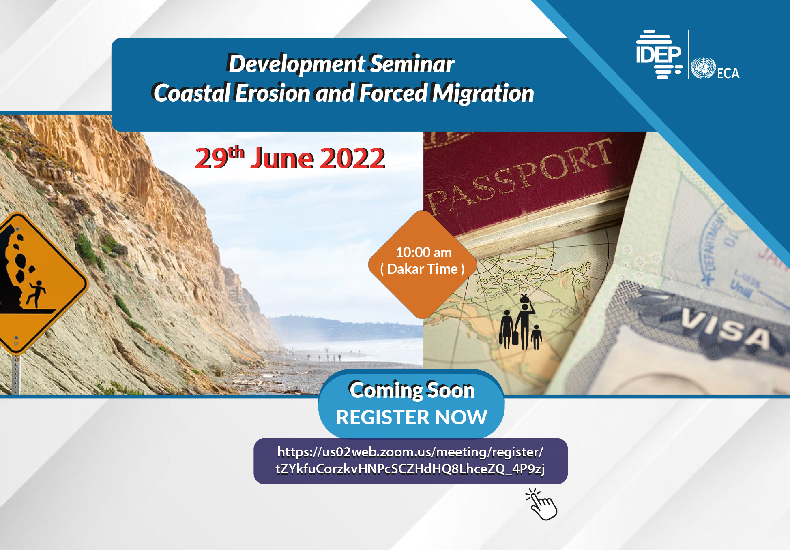
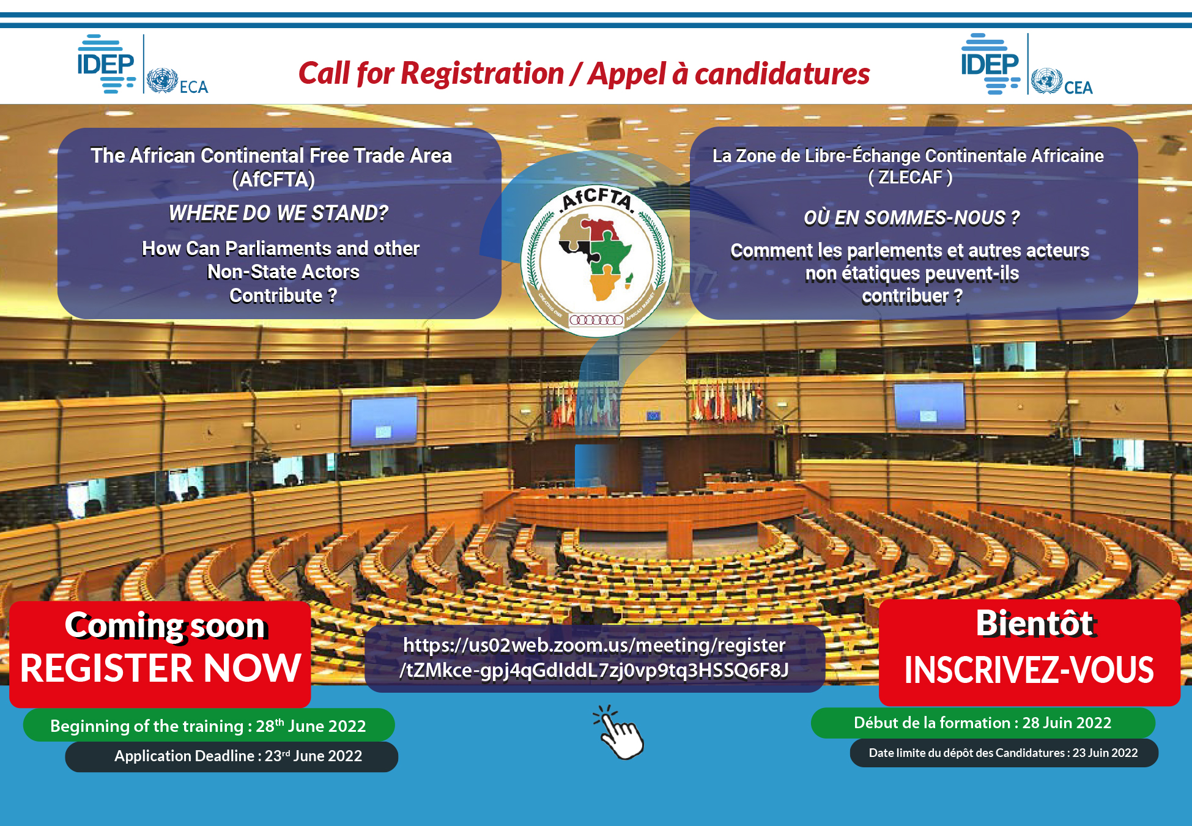


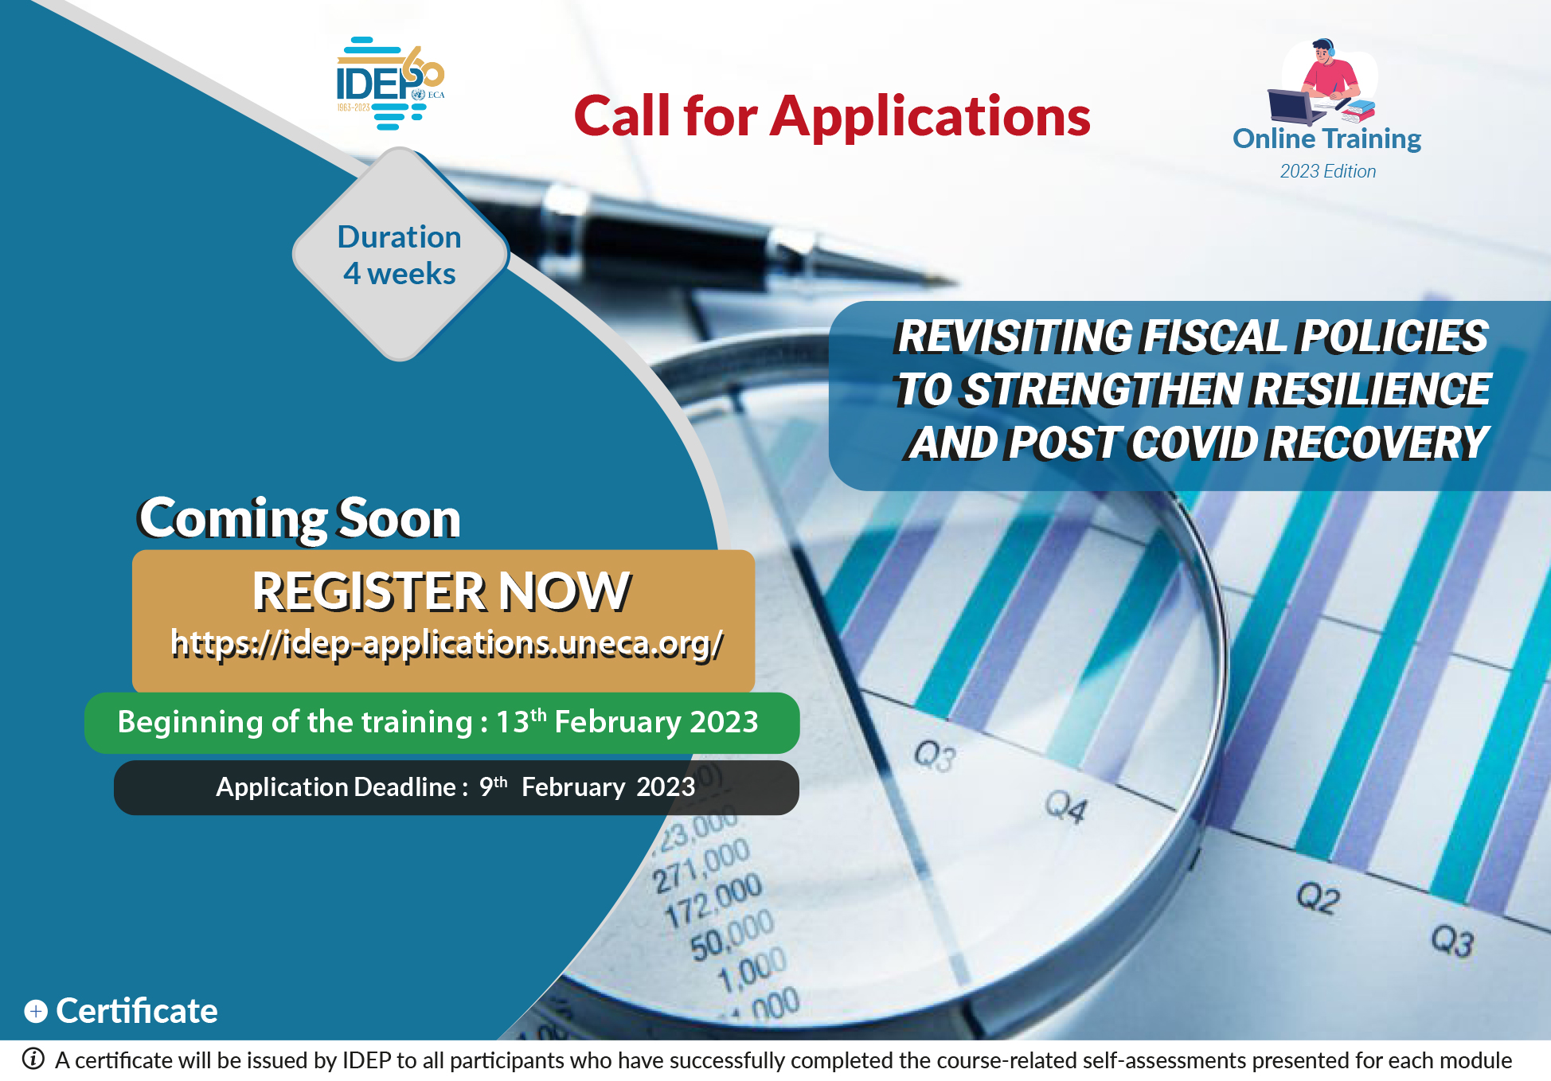
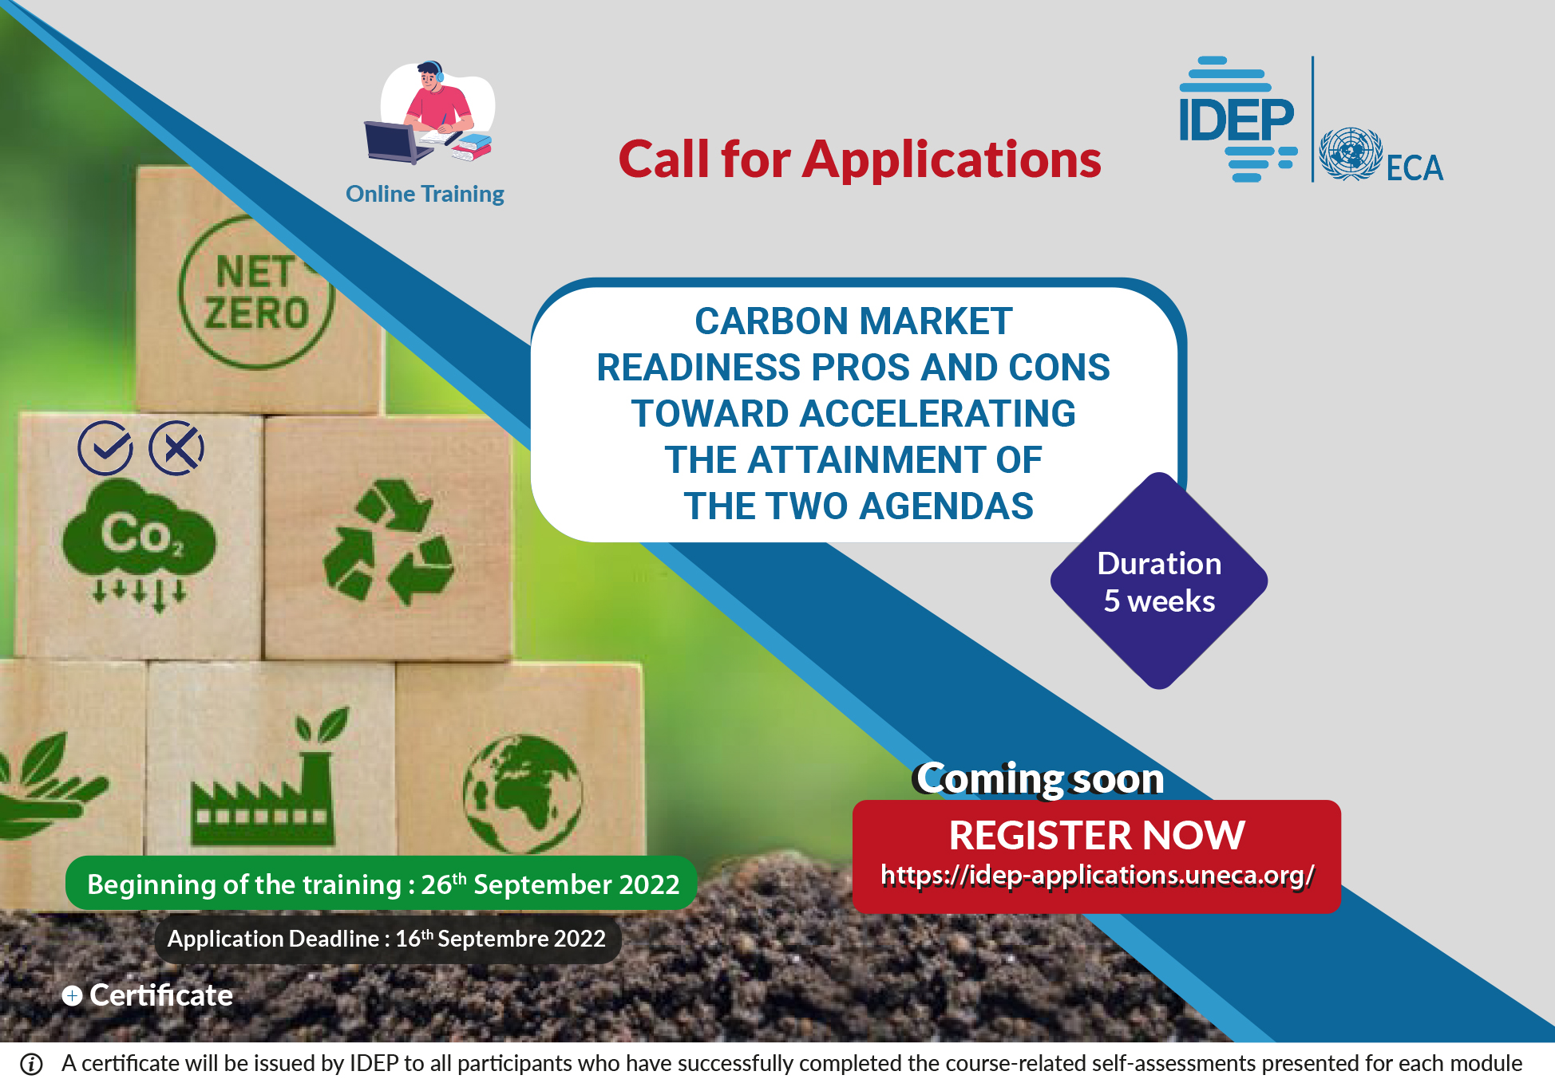

2022/23 Thematic Areas
  Empowerment of women & young people
  Climate change
  Opportunities & challenges stemming from the establishment
  of the AfCFTA
  Innovative financing mechanisms to support
  the Continent’s recovery
  Natural resource governance
  Macroeconomic modelling & Risk management

Slide 3
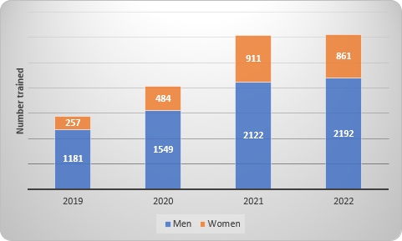
Participation
  3,053 trainees from 45 African Members States over 54 courses
  1,438 government officials, young experts & students (415 women) trained to design gender responsive policies and resilient strategies for the post-pandemic era
  AfCFTA course to 428 parliamentarians and NGO experts
  1000+ participants in research activities, strengthening the link between
  development research and policy action
  and providing a framework for open debate
  and innovative thinking
Number of Beneficiaries (2019 – 2022)

Slide 4



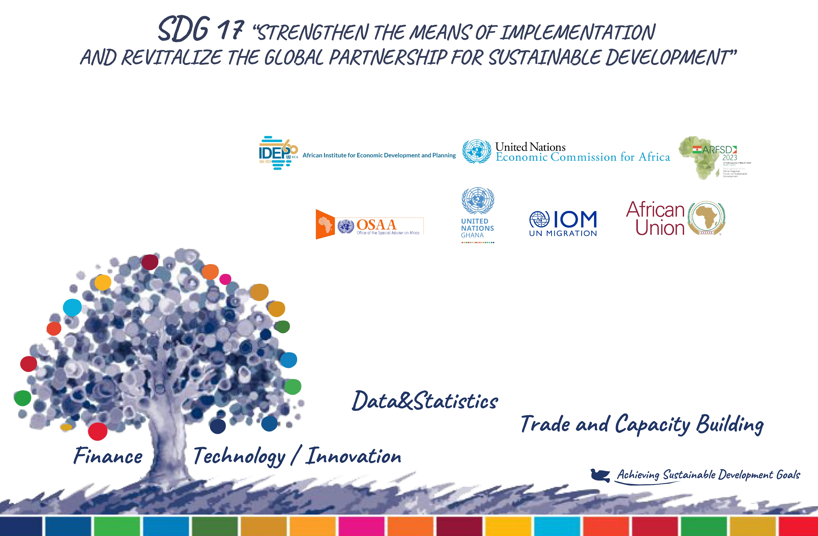
Strategic partnerships in line with ECA’s priorities
  Research project on “Debt, taxation and financing for development: immediate responses to global emergencies” with
  Two-year training program on making the AfCFTA effective, with the aim of boosting intra-African trade
  Support of the Government of Italy and ASeS (Farmers Solidarity and Development)
  Second cohort of the Pan-African initiative for the digital transformation of TVET& skills development with
  Training program designed for The Government of the Gambia on planning & risk management
  Capacity building activities with: the African Union Commission, 4 RECs (ECOWAS, ECCAS, IGAD and SADC), various universities ( ), UNSytem, IOM, Networks of Journalists via Africa 21, etc.

Slide 5
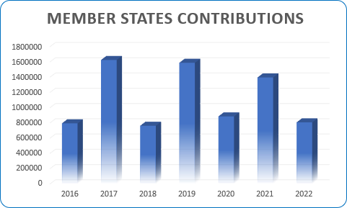
Resource Mobilization
MStates contributions continue to be uneven
Tx to the MStates who contributed in 2022
Unpaid assessed contributions stood at a high of $18.5 million as of 31 December 2022 with a heavy impact on the capacity of the Institute to fully address MStates expectations and implement its mandate
>> Need to increase support to IDEP
Gambia | 103 455
Lesotho | 30 000
Libya | 76 604
Madagascar | 20 000
Mali | 30 000
Morocco | 68 522
South Africa | 80 000
Sudan | 160 000
Tunisia | 13 914
Zambia | 223 471

Slide 6



Celebrating 60 Years of Social and Economic Planning
Achieving the UN-Common Agenda: Learning from six decades of capacity building and research
Building sustainability and resilience in Africa through sensitization of Member States, UN Partners & other stakeholders
Advocacy for continued capacity building towards the achievement of Agenda 2030 & Agenda 2063

Slide 7


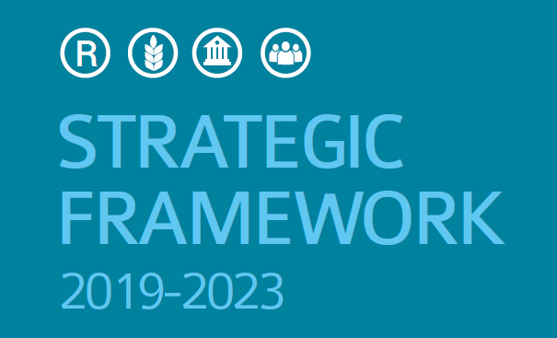
2023 Prospects
Finalisation of the membership of IDEP Governing Council
Sub Region | Members
Central Africa | Equatorial Guinea (*) | CAR
East Africa | Rwanda | Ethiopia
North Africa | Sudan(*) | Mauritania
Southern Africa | Botswana | Mozambique
West Africa | Guinea(*) | Ghana(*)
Permanent members:
Senegal and AUC
(*) 2nd term
Evaluation of the 2019-2023 Strategic Plan
Design of the 2024-2024 Strategic Plan
African Institute for Economic Development and Planning
Inaugural meeting of IDEP GC: June 2023
Meeting to review 2024-2029 Strategic Plan: December 2023

Slide 8
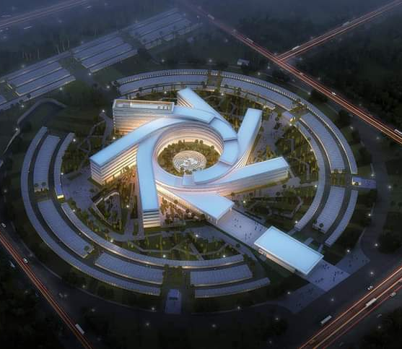
2023 Prospects . . .
  More tailor-made capacity building activities for Member States & RECs
  Resuming progressively in-situ activities to strengthen hands-on learning
  Resource mobilization strategy to recover arrears & more regular contributions from Member States
  Increase of the UN Grant

Slide 9
THANK YOU!
Follow the conversation: #COM2023
More: www.uneca.org/cfm2023

