Slide 1
Fifty-fifth Session of the Economic Commission for Africa
Hanan Morsy
Deputy Executive Secretary and Chief Economist, UNECA
15 March 2023

Slide 2
Recent crises have exacerbated the existing socio-economic inequities….
Title
Africa is facing a perfect storm of overlapping and recurring crises.
The COVID-19 pandemic, the war in Ukraine and climate change have exacerbated poverty and inequality, which were already significant even before the pandemic.
Poverty and inequality pose risks to the achievement of the SDGs and to Africa’s prosperity, peace and security, and the social contract.
There is an urgent need to foster a development model centered around people and to mainstream poverty and inequality into national and regional development strategies.

Slide 3
…with appallingly high rates of poverty (2022)…
Africa accounts for the highest proportion of the world’s poor – 54.8 per cent in 2022 (overtaking South Asia – 37.6 per cent).
546 million people were living in poverty in 2022, a 74% increase since 1990.
149 million non-poor Africans (whose consumption was 20% above the poverty line) were at risk of falling into poverty in 2022.
East and West Africa account for high numbers of non-poor people at risk of falling into poverty in 2022 (48 and 52 million, respectively).

Slide 4
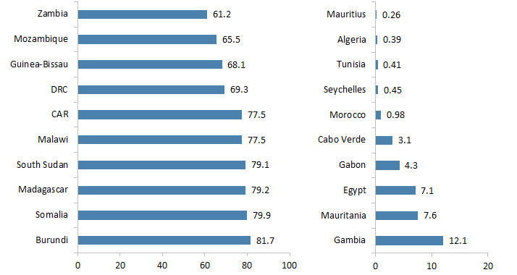
..concentrated in Lower-Middle-Income countries.
Countries with the highest and lowest proportion of poor, 2022
(Percentage of the population)
Highest proportion of poor
Lowest proportion of poor
Lower-middle-income countries (LMICs) in Africa account for over 52% of the total poor in Africa.
Low-income countries represent 45% of the poor in Africa.
Source: Calculations by the Economic Commission for Africa (ECA) using the PovcalNet database of the World Bank (accessed November 2022).

Slide 5
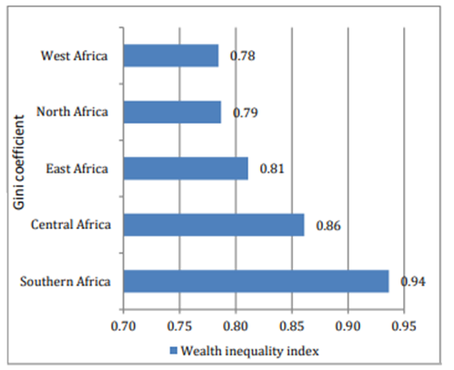
Poverty is exacerbated by existing inequalities….
Wealth inequality in Africa, by subregion
While inequality is pervasive across all African sub-regions, it is particularly high in Southern Africa.
On the other hand, despite having a disproportionate share of people living in poverty (32%), West Africa has the lowest wealth inequality across sub-regions (Gini at 0.78).
Source: Calculations by the Economic Commission for Africa (ECA) using the World Inequality
Index database of the World Bank (accessed November 2022).

Slide 6
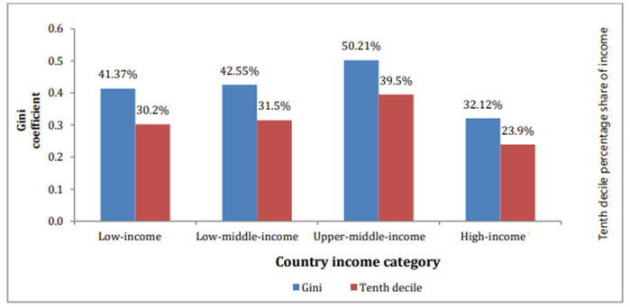
….with highest income inequality in upper-middle income countries.
Income inequality by level of country income
However, income inequality is highest among upper-middle income countries such as South Africa, Namibia and Botswana.
This reinforces that focus solely on growth is insufficient to tackle inequality. We need more targeted policies.
Source: Calculations by the Economic Commission for Africa (ECA) using the PovcalNet database of the World Bank (accessed November 2022).
Note: The Gini coefficient columns reflect the incidence of income inequality (ranging from 0 for perfect equality to 1 for extreme inequality). The tenth decile columns reflect the income share held by the top 10% of the population. For example, in the upper-middle-income countries, the top 10% of the population owned 39.5% of the income.

Slide 7
Some Recommended Actions for discussion…
  Pursue pro-poor and inclusive macro-economic policies, with spending targeted at safety nets to support the poor and most vulnerable.
  Ensure resource mobilization for an inclusive recovery, including through fair taxes and by leveraging climate finance for decent job creation.
  Carve a structural development path that is just and meets people’s needs, with industrialization and the AfCFTA acting as catalysts.

Slide 8
Some Recommended Actions for discussion…
  Advance reforms for a more just and inclusive global financial architecture
    Overhaul the G20 Common Framework and enhance debt regulatory framework
    Reform the SDR rechannelling mechanism to promote greater utilization, and for SDR allocations to be considered in a rule-based, analytical manner.
    Scale up affordable and long-term financing for development.
    Increase the flexibility of eligibility and qualification criteria of the IMF’s Resilience and Sustainability Trust to play a catalytic role in green financing.
    Reinvigorate the IMF’s toolkit in response to more frequent shocks.
    Enhance regulatory framework for credit rating agencies and utilize derisking instruments to enhance market access.

Slide 9
THANK YOU!
Follow the conversation: #COM2023
More: www.uneca.org/cfm2023

