Slide 1
Report of the eighth session of the Committee on Statistics and Data
(Doc Ref. No.: E/ECA/COE/41/12)
Oliver Chinganya
Director, African Centre for Statistics
Thursday, 16 March

Slide 2
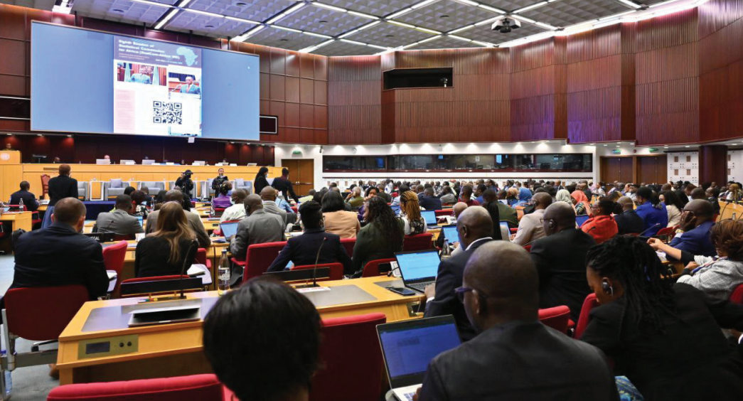
The 8th meeting of the StatCom-Africa
Theme: “Modernizing the data ecosystem in Africa to support regional integration”
StatCom Bureau: Chair: Ethiopia, 1st Vice-Chair, Chad 2nd Vice-Chair: Egypt 1st Rapporteur: United Republic of Tanzania 2nd Rapporteur: Cabo Verde;
Delegates from 51 Member States
Observers from 27 entities
Joint sessions with UNGGIM for Africa and the group of Experts of the Conference of African Ministers Responsible for Civil Registration
11 side events
7 statutory reports represented & discussed
Issues discussed
Modernizing the data ecosystem
Capacity building
Census
Civil registration
Gender statistics
System of National Accounts
Geospatial information and statistics
Big data and data science
Young statisticians programme

Slide 3


Key issues……
Title
  Took stock of the challenges faced & opportunities available – in the African Statistical System
  Discussed the Road Map for the Transformation and Modernization (T&M) of official statistics in Africa
    Road map sets out principles and priorities for T&M
    Guides countries on ways to optimize Transformation & Modernization
Wide diversity & specificities of National Statistical Systems
Nationally tailored Road Maps
International standards
T&M Must be beneficial for all countries and all users

Slide 4

Key issues…..
Title
Other of Statcom resolutions
Programme of work on data and statistics for 2023–2024
Statistical capacity development in Africa
Regional report on SDGs indicators
The 2020 round of population and housing censuses
Civil registration and vital statistics and United Nations legal identity agenda
Gender statistics
Implementation of the 2008 System of National Accounts and related statistics
Integration of geospatial and statistical information
Modernizing the data ecosystem in Africa
Reports on side events
  Creation of the Takwimu Young African Statisticians Programme

Slide 5





The Ask?…….Resolutions submitted to the COM
Title
To endorse/ take note
To empower
The report and recommendations of the 8th session of the Statistical Commission for Africa and the 8th meeting of the Regional Committee of UNGGIM
The recommendations of the
Expert Group for the conference
of ministers for CRVS
ECA and partners to support national statistical systems
To enable
To support
Domestic resource mobilization to implement national road maps for transformation and modernization
The integration of statistics and geospatial information and development of economic, social (including CRVS), and environmental statistics and systems

Slide 6

Reflections… Economic Value of Data
Data is a valuable “asset”
Key conclusions
Determine the existence & impact of regional value chains
Determine the volume of trade between countries
Determine the flows of trade to trace the value added of each country to provide business opportunities that will enhance industrialization in line with AfCFTA
(Trade in Value Added -TiVA)
Determine the acceleration of SDGs implementation
The Power of Data
Need to invest in data systems
Finance for Data mechanism (strategy)
Analysis of recent investment in data shows an average economic benefit of $32 for every $ invested

Slide 7
THANK YOU!
Follow the conversation: #COM2023
More: www.uneca.org/cfm2023

